Slide 1
Streaming data analytics with Power BI and Databricks
Liping Huang Marius Panga
Databricks 2023

Slide 2
Agenda
Lakehouse for Real-Time Analytics
Architectural Patterns and Demos
Considerations

Slide 3










New opportunities from real-time data
Every organization generates vast amounts of real-time data
Creating opportunities for new kinds of real-time applications
Transactional records
Point of sale (POS)
Banking transactions
Airline reservations
Call center records
Third-party
News feeds
Weather
Market data
Real-time traffic
Fraud detection
Personalized offer
Vaccine distribution
Smart pricing
In-game analytics
Connected cars
and smart devices
Interactions
Web clicks
Social posts
Emails
Instant messages
IoT events
Sensors
Geolocation
Machine logs
Mobile devices
Predictive maintenance
Content recommendations

Slide 4



Data streaming is hard for most organizations
New APIs and languages to learn
Complex operational tooling to build
Real-time and historical data in separate systems
Difficult to enable existing data teams with the languages and tools they already know
Difficult to deploy and maintain streaming data pipelines that run reliably in your production environment
Incompatible governance models limit ability to control access for the right users and groups

Slide 5





Data streaming made simple
Real-time analytics, machine learning and applications on one platform
Lakehouse Platform
Data
Warehousing
Data Engineering
Data Streaming
Data Science
and ML
Enable all your data teams
Data engineers, data scientists, and analysts can easily build streaming data pipelines with the languages and tools they already know.
Unity Catalog Unified governance for all data assets
Simplify development and operations
Reduce complexity by automating many of the production aspects associated with building and maintaining real-time data workflows.
Delta Lake
Data reliability and performance
Cloud Data Lake
All structured and unstructured data
One platform for streaming batch and data
Eliminate data silos, centralize security and governance models, and provide complete support for all your real-time use cases.

Slide 6

This is not a deep dive into
Power BI
Delta Live Tables (DLT)
Structured Streaming
Databricks SQL (DB SQL)

Slide 7












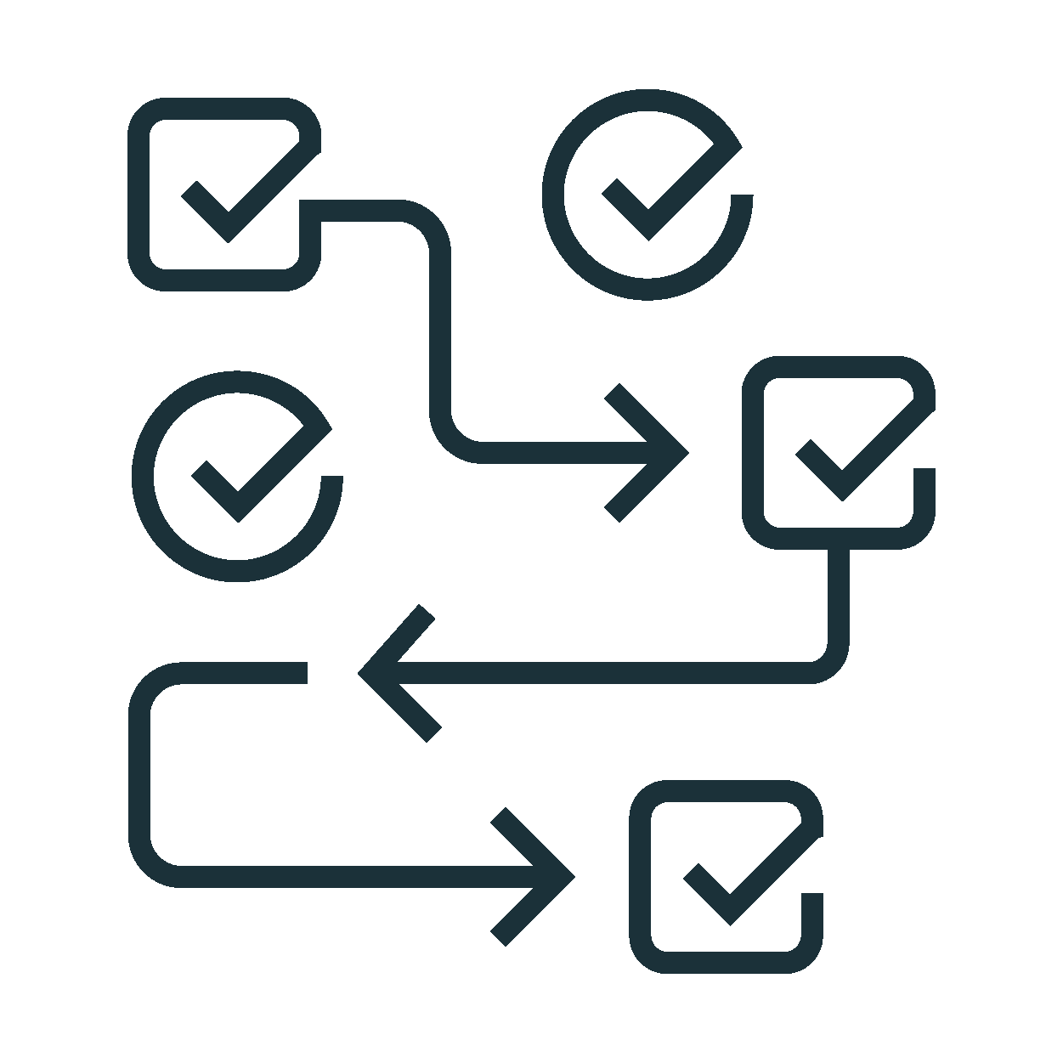











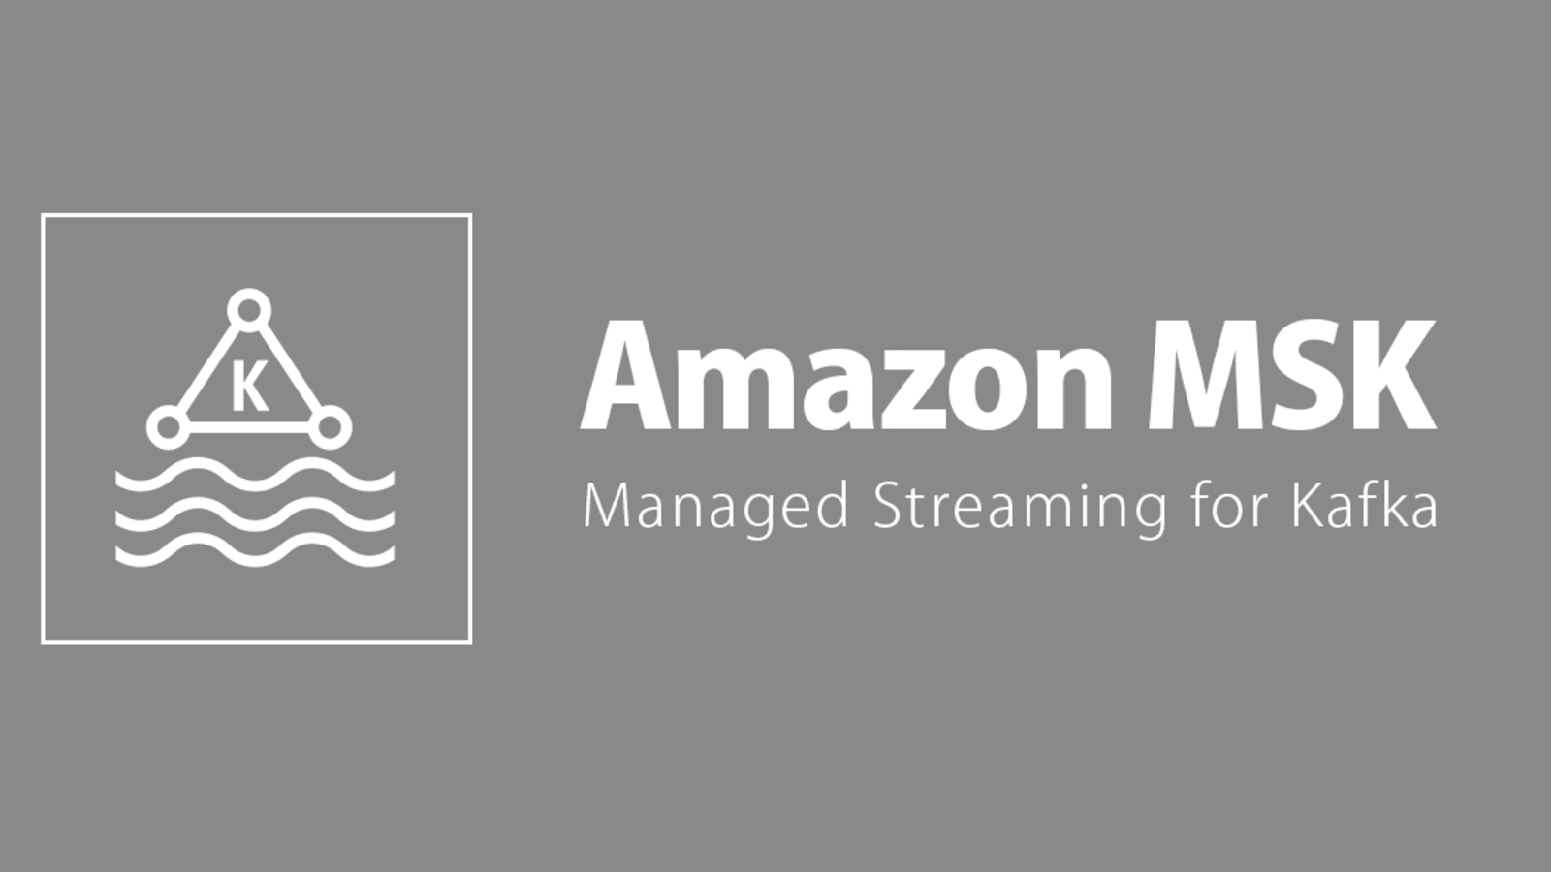











Scenario 1
Data Sources
Object Stores
Lakehouse Platform
Data Warehouse
Amazon S3
Databricks Workflows for End to End Orchestration
Direct Query + Auto Refresh
Streaming Ingestion & Transformation with
Delta Live Tables
Real-Time Analytics with
Databricks SQL
On-premises Systems
Azure Data Lake Store
Power BI
Google Cloud Storage
Continuous
Ingestion
SaaS Applications
Data Transformation &. Quality
Enhanced Auto Scaling
Composite Datasets
Data Enrichment
Business Aggregates
Analytics / Dashboarding
Message Store
Machine & Application Logs
Automatic Deployment & Operations
Data Pipeline Observability
Automatic Error Handling & Recovery
Power BI
Real-Time Applications with
Spark Structured Streaming
Streaming Dataset
Application Events
Amazon MSK
Streaming Enrichment
Kinesis Data Streams
Streaming Connectors
Streaming Connectors
Filter
Joins
Aggregate
Windowing
Mobile & IoT Data
Azure Event Hubs
GCP Pub/Sub
Power BI
Unity Catalog
Photon
For Governance

Slide 8
Scenario 1
Data processing framework
Declarative pipelines
Data quality enforcement
Streaming and batch
Data Sources
Object Stores
Lakehouse Platform
Data Warehouse
Amazon S3
Databricks Workflows for End to End Orchestration
Direct Query + Auto Refresh
Streaming Ingestion & Transformation with
Delta Live Tables
Real-Time Analytics with
Databricks SQL
On-premises Systems
Azure Data Lake Store
Power BI
Google Cloud Storage
Continuous
Ingestion
SaaS Applications
Data Transformation &. Quality
Enhanced Auto Scaling
Composite Datasets
Data Enrichment
Business Aggregates
Analytics / Dashboarding
Message Store
Machine & Application Logs
Automatic Deployment & Operations
Data Pipeline Observability
Automatic Error Handling & Recovery
Power BI
Real-Time Applications with
Spark Structured Streaming
Streaming Dataset
Application Events
Amazon MSK
Streaming Enrichment
Kinesis Data Streams
Streaming Connectors
Streaming Connectors
Filter
Joins
Aggregate
Windowing
Mobile & IoT Data
Azure Event Hubs
GCP Pub/Sub
Power BI
Unity Catalog
Photon
For Governance

Slide 9
Scenario 1
SQL warehouse on your Lakehouse
Intuitive environment for data analysts
Serverless or dedicated
Rich ecosystem
Data Sources
Object Stores
Lakehouse Platform
Data Warehouse
Amazon S3
Databricks Workflows for End to End Orchestration
Direct Query + Auto Refresh
Streaming Ingestion & Transformation with
Delta Live Tables
Real-Time Analytics with
Databricks SQL
On-premises Systems
Azure Data Lake Store
Power BI
Google Cloud Storage
Continuous
Ingestion
SaaS Applications
Data Transformation &. Quality
Enhanced Auto Scaling
Composite Datasets
Data Enrichment
Business Aggregates
Analytics / Dashboarding
Message Store
Machine & Application Logs
Automatic Deployment & Operations
Data Pipeline Observability
Automatic Error Handling & Recovery
Power BI
Real-Time Applications with
Spark Structured Streaming
Streaming Dataset
Application Events
Amazon MSK
Streaming Enrichment
Kinesis Data Streams
Streaming Connectors
Streaming Connectors
Filter
Joins
Aggregate
Windowing
Mobile & IoT Data
Azure Event Hubs
GCP Pub/Sub
Power BI
Unity Catalog
Photon
For Governance

Slide 10
Scenario 1
Direct Query dataset
Automatic Page Refresh turned on
Data Sources
Object Stores
Lakehouse Platform
Data Warehouse
Amazon S3
Databricks Workflows for End to End Orchestration
Direct Query + Auto Refresh
Streaming Ingestion & Transformation with
Delta Live Tables
Real-Time Analytics with
Databricks SQL
On-premises Systems
Azure Data Lake Store
Power BI
Google Cloud Storage
Continuous
Ingestion
SaaS Applications
Data Transformation &. Quality
Enhanced Auto Scaling
Composite Datasets
Data Enrichment
Business Aggregates
Analytics / Dashboarding
Message Store
Machine & Application Logs
Automatic Deployment & Operations
Data Pipeline Observability
Automatic Error Handling & Recovery
Power BI
Real-Time Applications with
Spark Structured Streaming
Streaming Dataset
Application Events
Amazon MSK
Streaming Enrichment
Kinesis Data Streams
Streaming Connectors
Streaming Connectors
Filter
Joins
Aggregate
Windowing
Mobile & IoT Data
Azure Event Hubs
GCP Pub/Sub
Power BI
Unity Catalog
Photon
For Governance

Slide 11
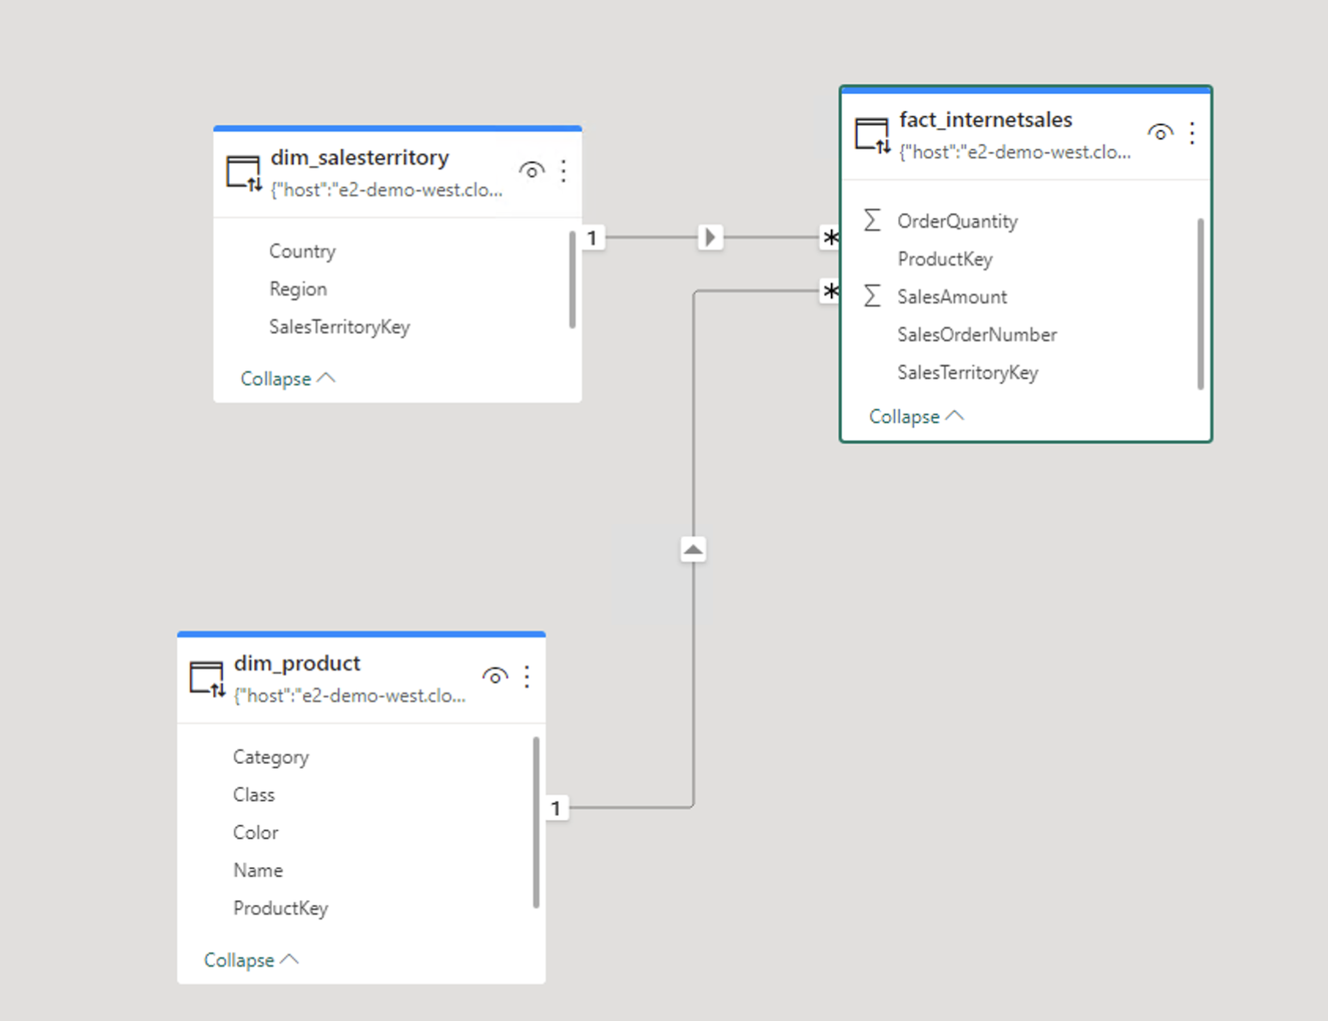
Demo
Databricks DLT
Databricks SQL
Power BI Direct Query
Power BI Auto Page Refresh

Slide 12
Scenario 2
Data Sources
Object Stores
Lakehouse Platform
Data Warehouse
Amazon S3
Databricks Workflows for End to End Orchestration
Direct Query + Auto Refresh
Streaming Ingestion & Transformation with
Delta Live Tables
Real-Time Analytics with
Databricks SQL
On-premises Systems
Azure Data Lake Store
Power BI
Google Cloud Storage
Continuous
Ingestion
SaaS Applications
Data Transformation &. Quality
Enhanced Auto Scaling
Composite Datasets
Data Enrichment
Business Aggregates
Analytics / Dashboarding
Message Store
Machine & Application Logs
Automatic Deployment & Operations
Data Pipeline Observability
Automatic Error Handling & Recovery
Power BI
Real-Time Applications with
Spark Structured Streaming
Streaming Dataset
Application Events
Composite Query dataset
Automatic Page Refresh turned on
Amazon MSK
Kinesis Data Streams
Streaming Enrichment
Streaming Connectors
Streaming Connectors
Filter
Joins
Aggregate
Windowing
Mobile & IoT Data
Azure Event Hubs
GCP Pub/Sub
Power BI
Unity Catalog
Photon
For Governance

Slide 13
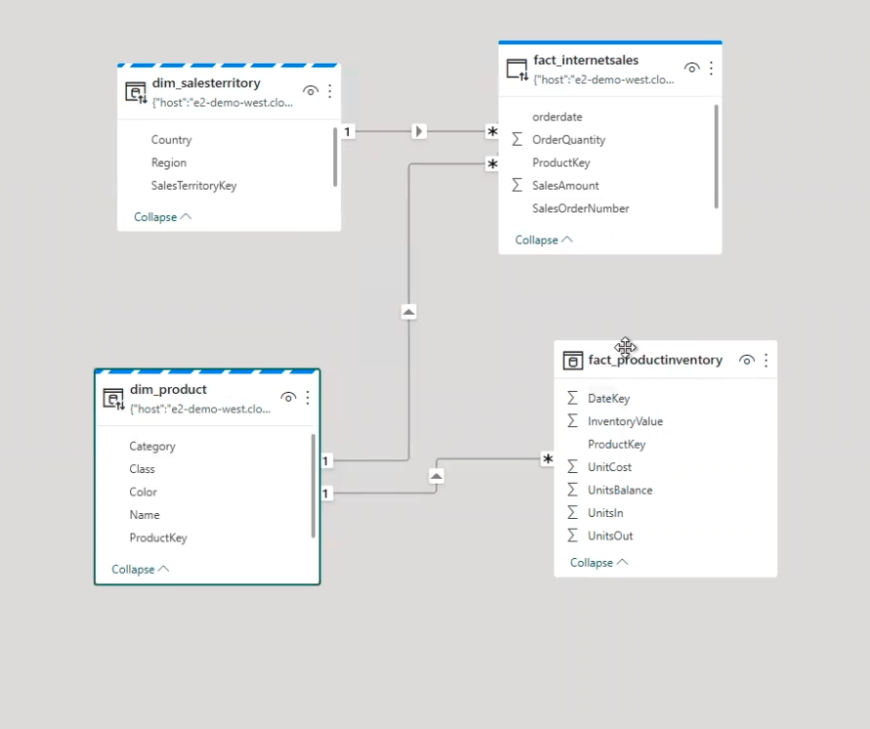
Demo
Databricks DLT
Databricks SQL
Power BI Composite Dataset
Power BI Auto Page Refresh

Slide 14
Scenario 3
Data Sources
Object Stores
Lakehouse Platform
Data Warehouse
Amazon S3
Databricks Workflows for End to End Orchestration
Direct Query + Auto Refresh
Streaming Ingestion & Transformation with
Delta Live Tables
Real-Time Analytics with
Databricks SQL
On-premises Systems
Azure Data Lake Store
Power BI
Google Cloud Storage
Continuous
Ingestion
SaaS Applications
Data Transformation &. Quality
Enhanced Auto Scaling
Composite Datasets
Data Enrichment
Business Aggregates
Analytics / Dashboarding
Message Store
Machine & Application Logs
Automatic Deployment & Operations
Data Pipeline Observability
Automatic Error Handling & Recovery
Power BI
Real-Time Applications with
Spark Structured Streaming
Streaming Dataset
Application Events
Amazon MSK
Streaming Enrichment
Kinesis Data Streams
Streaming Connectors
Streaming Connectors
Filter
Joins
Aggregate
Windowing
Mobile & IoT Data
Azure Event Hubs
GCP Pub/Sub
Power BI
Unity Catalog
Photon
For Governance

Slide 15
Scenario 3
Data Sources
Object Stores
Lakehouse Platform
Data Warehouse
Amazon S3
Databricks Workflows for End to End Orchestration
Direct Query + Auto Refresh
Streaming Ingestion & Transformation with
Delta Live Tables
Real-Time Analytics with
Databricks SQL
On-premises Systems
Azure Data Lake Store
Power BI
Google Cloud Storage
Continuous
Ingestion
SaaS Applications
Data Transformation &. Quality
Enhanced Auto Scaling
Manage your own checkpoints/infra
More Control/Flexibility
Handles (all) transformation logic
With/without persisting delta tables
Composite Datasets
Data Enrichment
Business Aggregates
Analytics / Dashboarding
Message Store
Machine & Application Logs
Automatic Deployment & Operations
Data Pipeline Observability
Automatic Error Handling & Recovery
Power BI
Real-Time Applications with
Spark Structured Streaming
Streaming Dataset
Application Events
Amazon MSK
Streaming Enrichment
Kinesis Data Streams
Streaming Connectors
Streaming Connectors
Filter
Joins
Aggregate
Windowing
Mobile & IoT Data
Azure Event Hubs
GCP Pub/Sub
Power BI
Unity Catalog
Photon
For Governance

Slide 16
Scenario 3
Data Sources
Object Stores
Lakehouse Platform
Data Warehouse
Amazon S3
Databricks Workflows for End to End Orchestration
Direct Query + Auto Refresh
Streaming Ingestion & Transformation with
Delta Live Tables
Real-Time Analytics with
Databricks SQL
On-premises Systems
Azure Data Lake Store
Power BI
Google Cloud Storage
Continuous
Ingestion
SaaS Applications
Data Transformation &. Quality
Enhanced Auto Scaling
Composite Datasets
Data Enrichment
Business Aggregates
Push API
Limited history
Power BI Service Only
No transformation
Analytics / Dashboarding
Message Store
Machine & Application Logs
Automatic Deployment & Operations
Data Pipeline Observability
Automatic Error Handling & Recovery
Power BI
Real-Time Applications with
Spark Structured Streaming
Streaming Dataset
Application Events
Amazon MSK
Streaming Enrichment
Kinesis Data Streams
Streaming Connectors
Streaming Connectors
Filter
Joins
Aggregate
Windowing
Mobile & IoT Data
Azure Event Hubs
GCP Pub/Sub
Power BI
Unity Catalog
Photon
For Governance

Slide 17
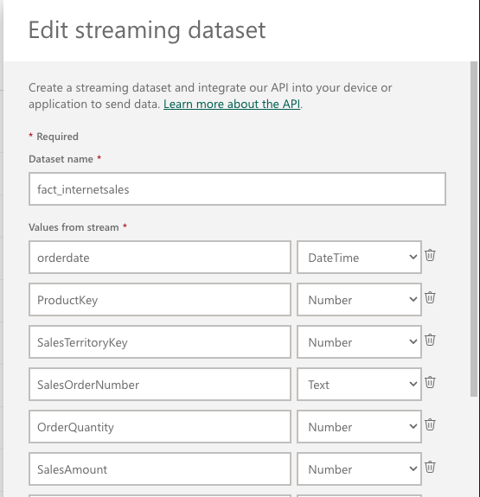
Demo
Spark Structured Streaming
Power BI Streaming Dataset

Slide 18
Databricks + Power BI streaming architecture
Data Sources
Object Stores
Lakehouse Platform
Data Warehouse
Amazon S3
Databricks Workflows for End to End Orchestration
Direct Query + Auto Refresh
Streaming Ingestion & Transformation with
Delta Live Tables
Real-Time Analytics with
Databricks SQL
On-premises Systems
Azure Data Lake Store
Power BI
Google Cloud Storage
Continuous
Ingestion
SaaS Applications
Data Transformation &. Quality
Enhanced Auto Scaling
Composite Datasets
Data Enrichment
Business Aggregates
Analytics / Dashboarding
Message Store
Machine & Application Logs
Automatic Deployment & Operations
Data Pipeline Observability
Automatic Error Handling & Recovery
Power BI
Real-Time Applications with
Spark Structured Streaming
Streaming Dataset
Application Events
Amazon MSK
Streaming Enrichment
Kinesis Data Streams
Streaming Connectors
Streaming Connectors
Filter
Joins
Aggregate
Windowing
Mobile & IoT Data
Azure Event Hubs
GCP Pub/Sub
Power BI
Unity Catalog
Photon
For Governance

Slide 19
In summary …
 | Scenario 1 DLT + DB SQL + PBI DQ | Scenario 2 DLT + DB SQL + PBI Composite | Scenario 3 Struct Streaming + PBI Streaming Dataset
Ease of implementation | Very easy | Easy | Medium
Latency | Medium (>3s) | Medium (>3s) | Low (<3s)
Historical data | Yes | Yes | Limited
Available PBI visuals | All | All | Basic

Slide 20

Considerations
Refresh interval to match expected new data arrival rate
Reduce number of visuals on a page
Toggle on Referential Integrity
Push down transformation logic to Databricks
Use SQL Warehouse for Power BI direct query / composite models
Choose the appropriate SQL Warehouse tier
Use Photon Acceleration
Use Event Logs of Delta Live Tables

Slide 21
Resources
Github link for demos on Cookbook (demos will be made available!)
Power Up your BI with Power BI and Lakehouse in Azure Databricks
Delta Live Tables
Structured Streaming
Power BI Page Auto Refresh

Slide 22


Get in touch
Marius Panga
Databricks Architect
https://www.linkedin.com/in/mariuspanga/
Liping Huang
Senior Solutions Architect
https://www.linkedin.com/in/lipinghuang119/

